Slide 1
Beijing
Deep learning on graphs
George Karypis
Senior Principal Scientist, AWS Deep Learning, Palo Alto, CA, USA

Slide 2
Agenda
Overview of graph neural networks
Overview of DGL API
Hands-on tutorials of basic GNN applications
DGL on SageMaker

Slide 3
Why should I be paying attention?
You will learn new ways to solve important problems in many domains.

Slide 4
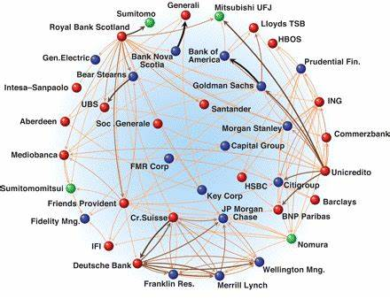
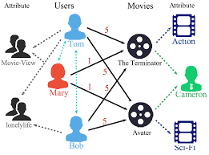
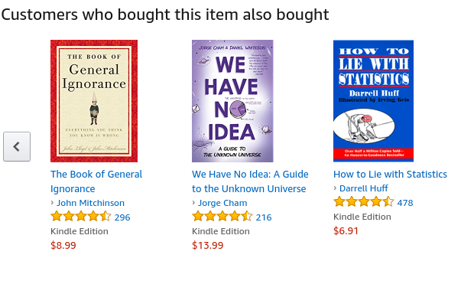
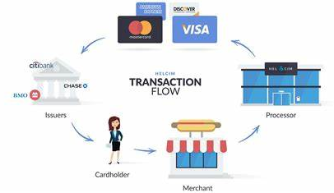
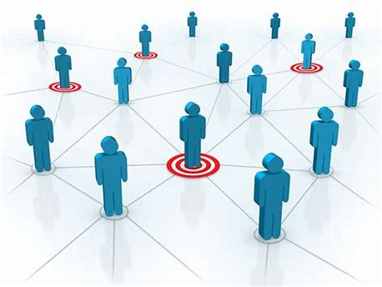
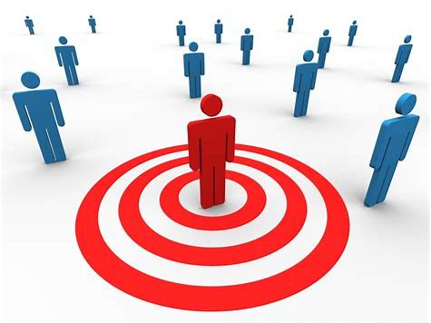
Fraud & Abuse
Recommendations
Detect malicious accounts, fraudulent financial transactions, fake reviews, fraudulent insurance claims, …
Products, media, articles, experiences, jobs, courses, spouses, …
Financial transactions network
Collaborative knowledge graph
Marketing
Who should get a discount? Who are the influencers? Who are the risk of churning?
Social network
Notes:
Graphs are present in many of these applications.

Slide 5
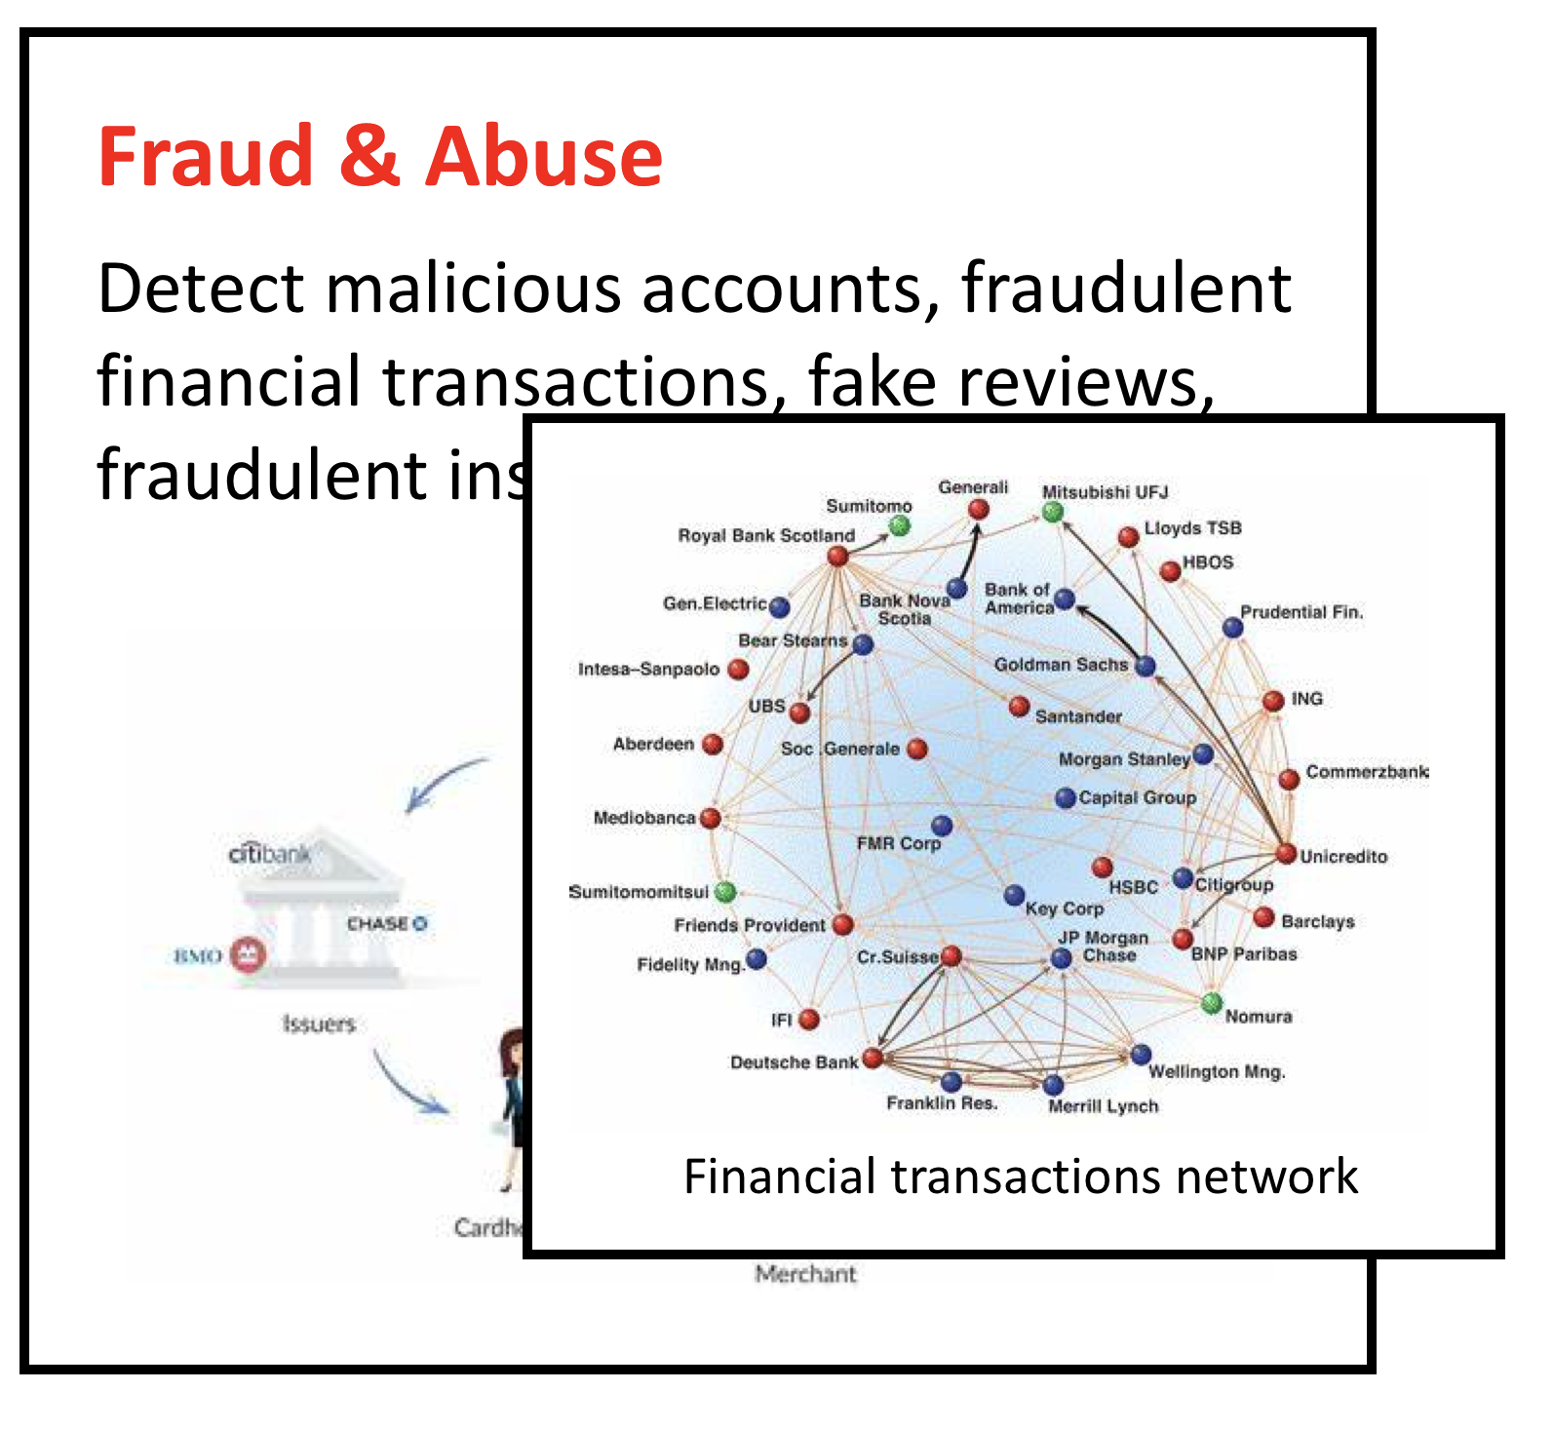
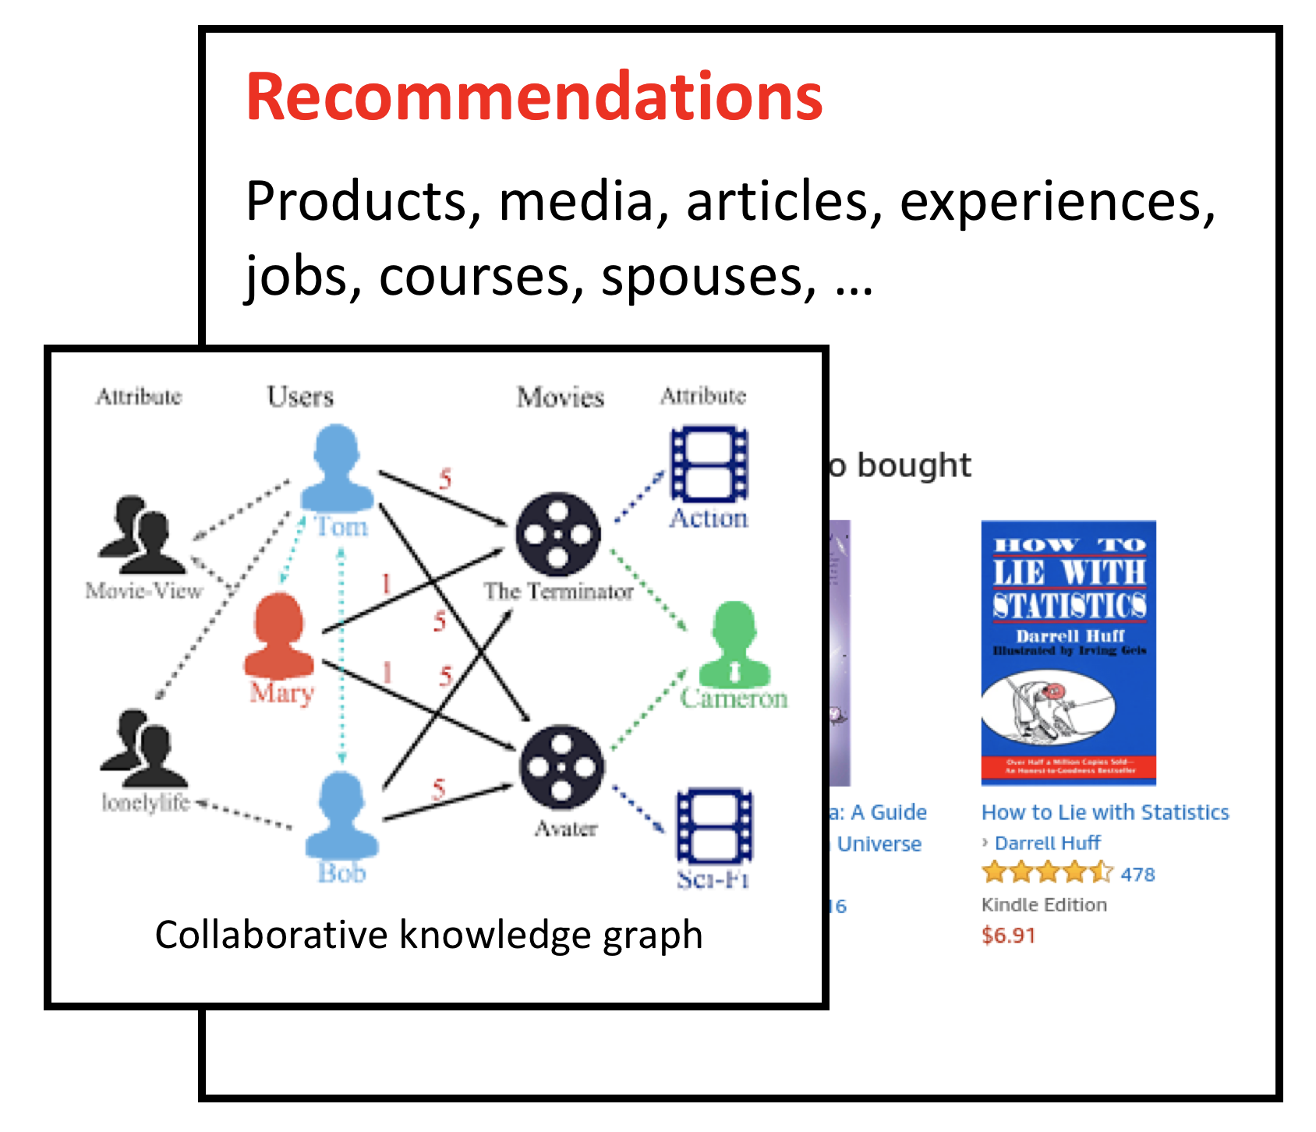
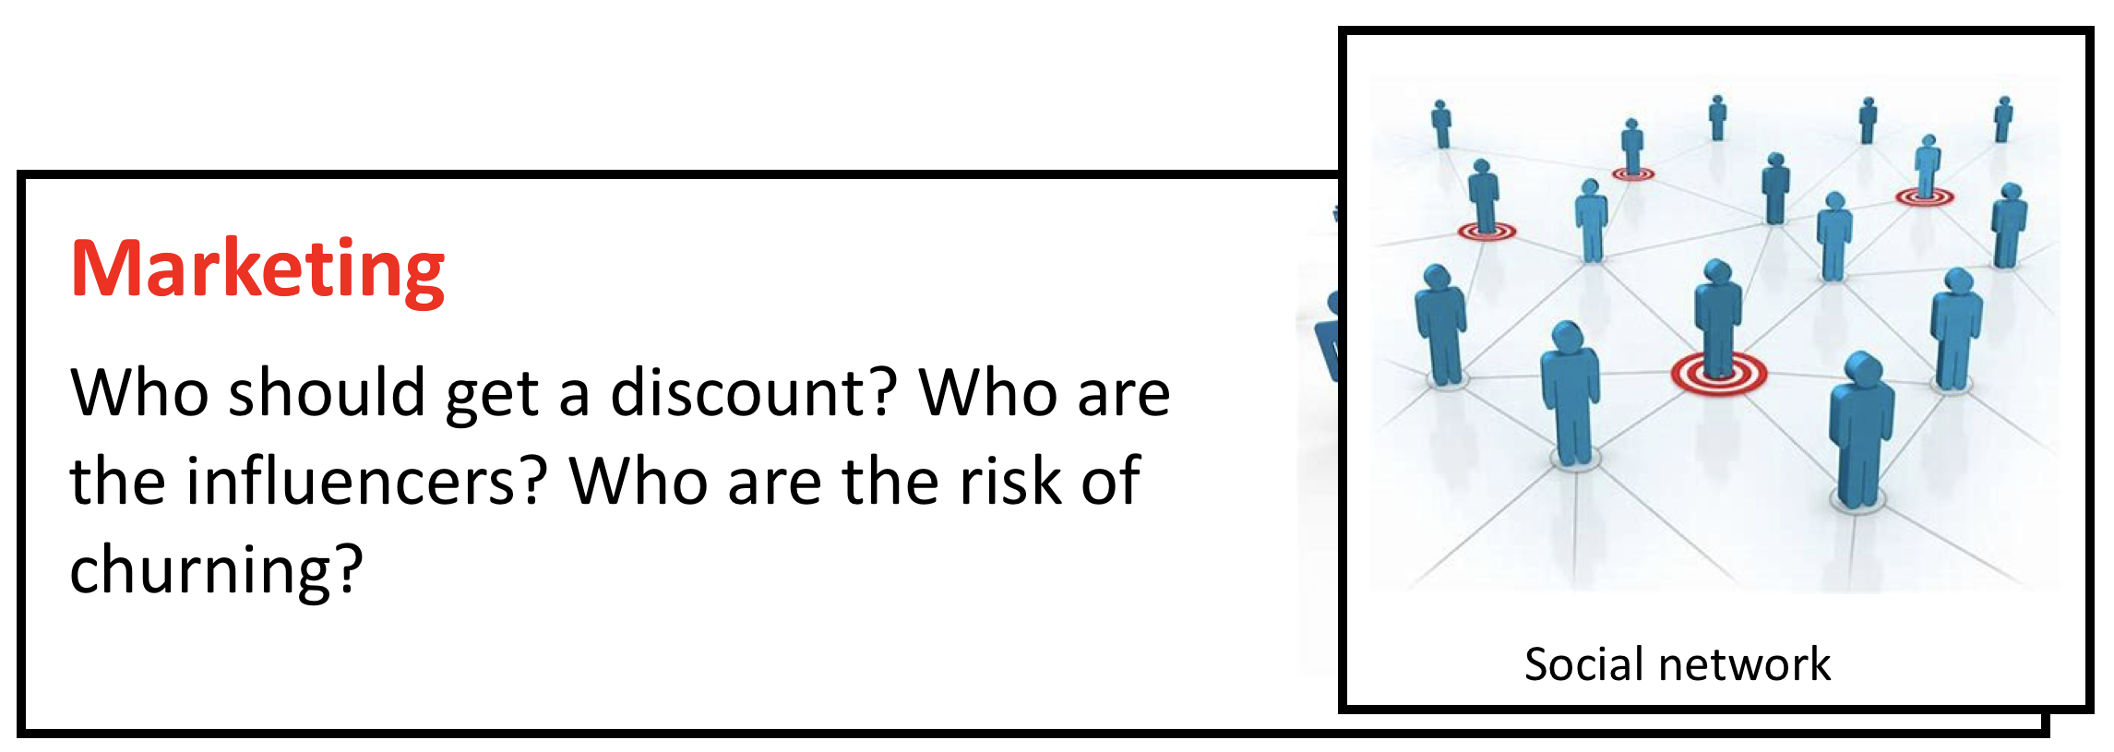
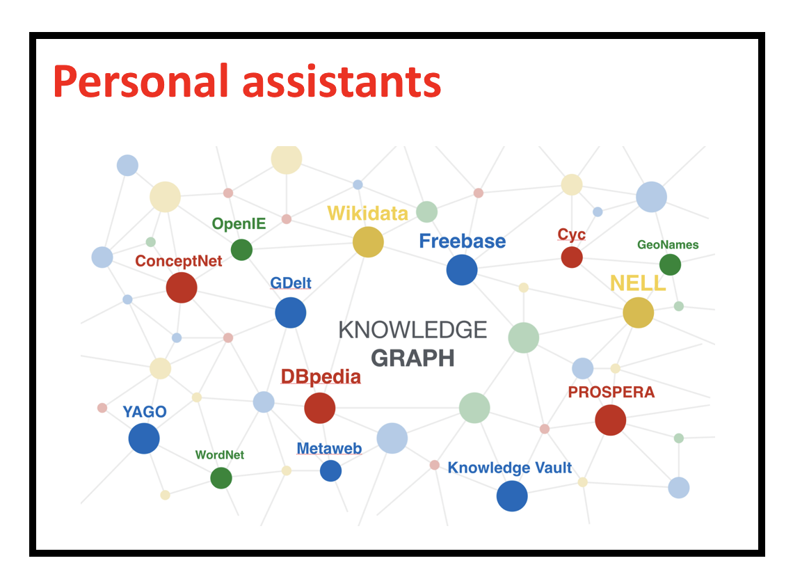
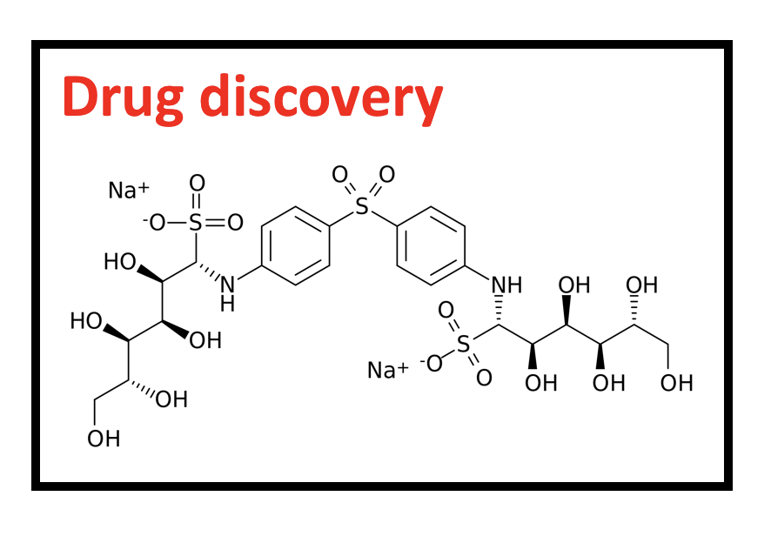
Tasks in graph learning
Node classification
Detect malicious accounts
Target right customers
Link prediction
Recommendations
Predict missing relations in a knowledge graph
Graph classification
Predict the property of a chemical compound

Slide 6
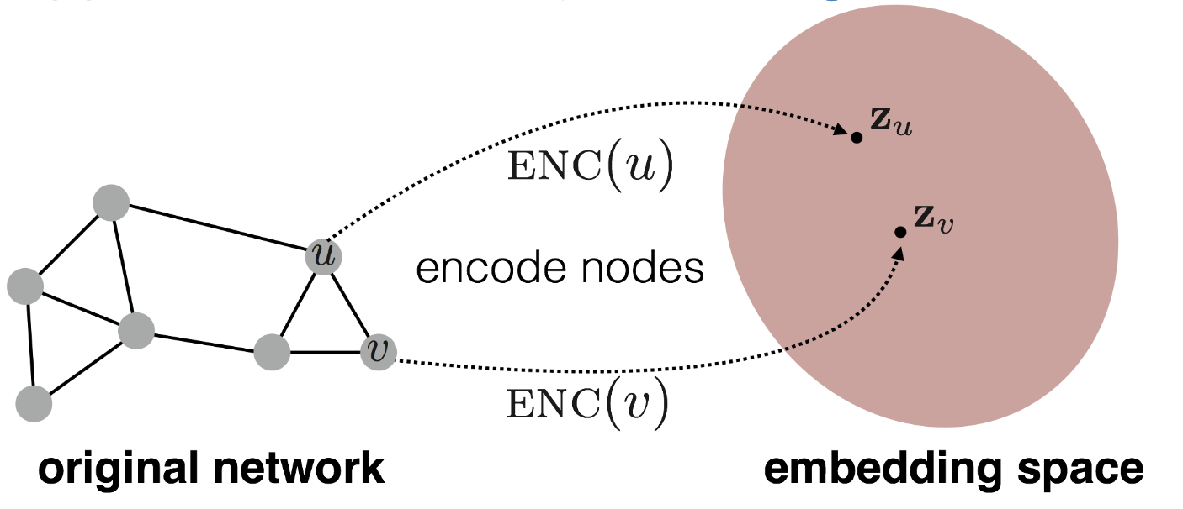
Graph learning and node embeddings
Embed nodes to a low-dimension space so that these embeddings capture the essential task-specific information and use them to train off-the-self classifiers.
For example, node similarities in the embedding space approximates the similarities in the original graph.
Representation Learning on Networks, snap.stanford.edu/proj/embeddings-www, WWW 2018

Slide 7
Traditional graph learning approaches
Generate embeddings by manual feature engineering
Requires domain expertise, involves considerable manual fine-tuning, time consuming, does not scale, …
Automatically generate embeddings using unsupervised dimensionality reduction approaches
Singular value decomposition, tensor decomposition, co-factorization, deep walks, etc.
Cannot effectively combine rich attributes with network structure.
Employ mostly (multi-)liner models.
Do not allow for end-to-end learning.

Slide 8
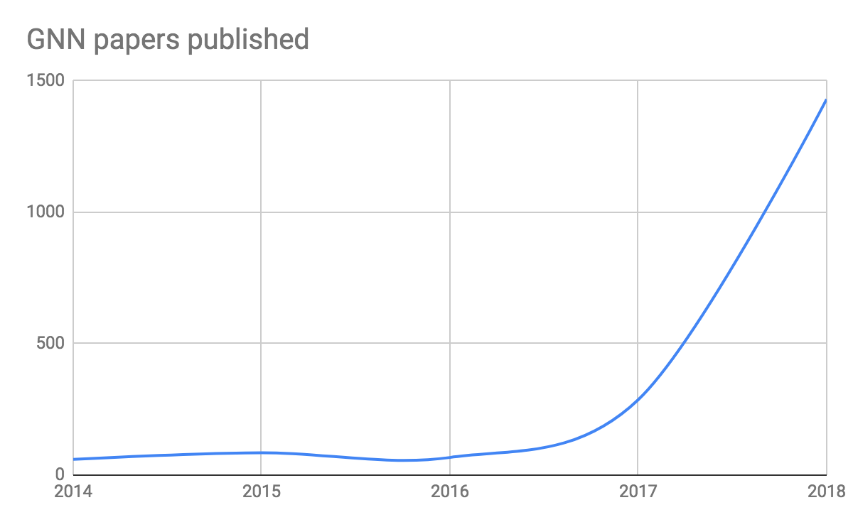
Can we do better?
Graph Neural Network (GNN)
A family of (deep) neural networks that learn node, edge, and graph embeddings.
They are becoming extremely popular.

Slide 9

Why are graph neural networks better?
GNNs compute node embeddings using both the structure of the graph and the features of the nodes and edges.
Name: xxx
Age: xxx
Sex: xxx
Title: How to lie with statistics
Author: Darrell Huff
Type: Kindle Edition
Price: $6.91
users
books

Slide 10
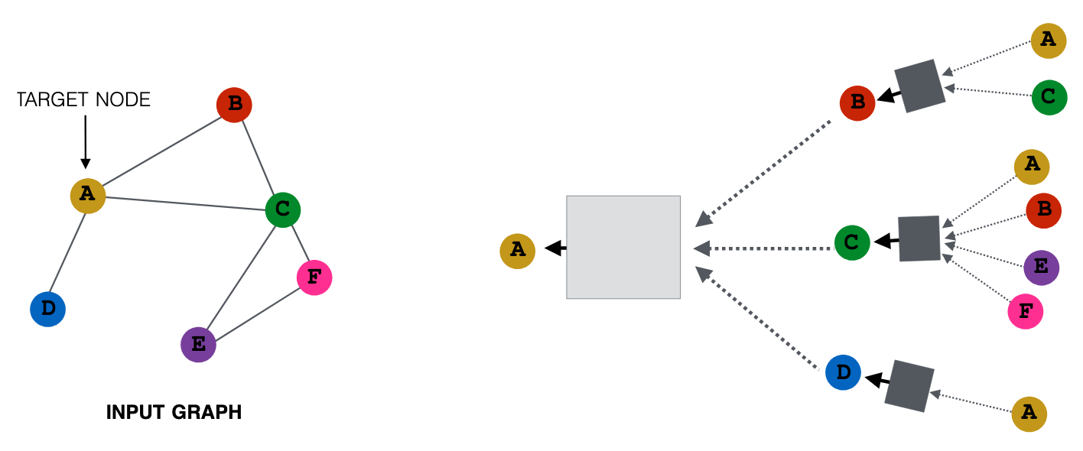
Why are graph neural networks better?
GNNs can integrate topologically distant information in a non-linear fashion.
Representation Learning on Networks, snap.stanford.edu/proj/embeddings-www, WWW 2018

Slide 11
Why are graph neural networks better?
GNNs and the downstream classification/regression models can be trained in an end-to-end fashion.
Traditional method
Classifier
GNN
Classifier

Slide 12
Why are graph neural networks better?
GNNs are naturally inductive because they learn the same neural networks on all the nodes and edges.
GNN
GNN

Slide 13
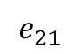
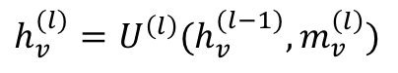
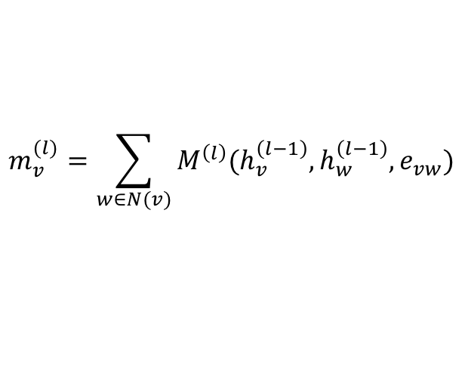
A general graph neural network formalism
Graph neural networks are based on message-passing
Reduce
Message
h₅
h₂
v₅
$$m_{v}^{(l)}=\sum_{w∈N(v)}{M^{\left(l\right)}(h_{v}^{\left(l−1\right)}, h_{w}^{\left(l−1\right)}, e_{vw})}$$
v₂
$$e_{21}$$
v₁
h₁
$$h_{v}^{(l)}=U^{\left(l\right)}(h_{v}^{(l−1)}, m_{v}^{\left(l\right)})$$
v₃
v₄
h₄
h₃
Neural Message Passing for Quantum Chemistry
Notes:
Message: tensor computed from source node/ destination node/ edge features
Reduce: aggregating the messages (and updating the node representation accordingly)

Slide 14
A multi-layer GNN
Multiple GNN layers can be stacked together.
Representation Learning on Networks, snap.stanford.edu/proj/embeddings-www, WWW 2018

Slide 15
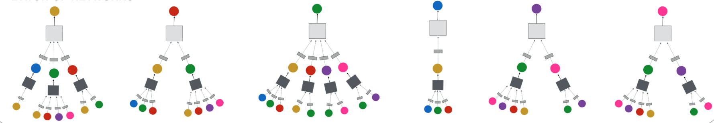
The power of GNN
An L-layer multi-layer GNN computes a node embedding based on the node and its local neighborhood up-to L hops away.

Slide 16
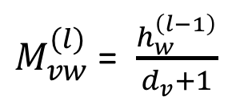
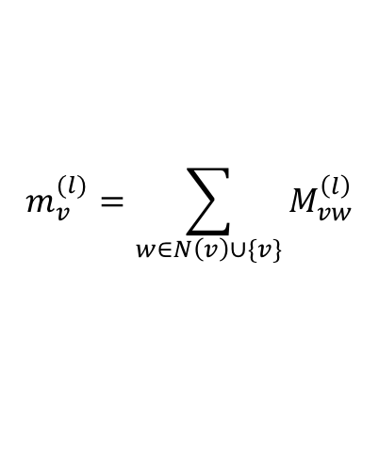
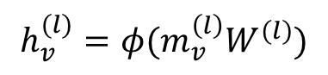
Example 1: Graph convolution network (GCN)
$M_{vw}^{(l)}$= $\frac{h_{w}^{\left(l−1\right)}}{d_{v}+1}$
$$m_{v}^{(l)}=\sum_{w∈N\left(v\right)∪\{v\}}{M_{vw}^{\left(l\right)}}$$
$$h_{v}^{(l)}=φ(m_{v}^{\left(l\right)}W^{(l)})$$

Slide 17
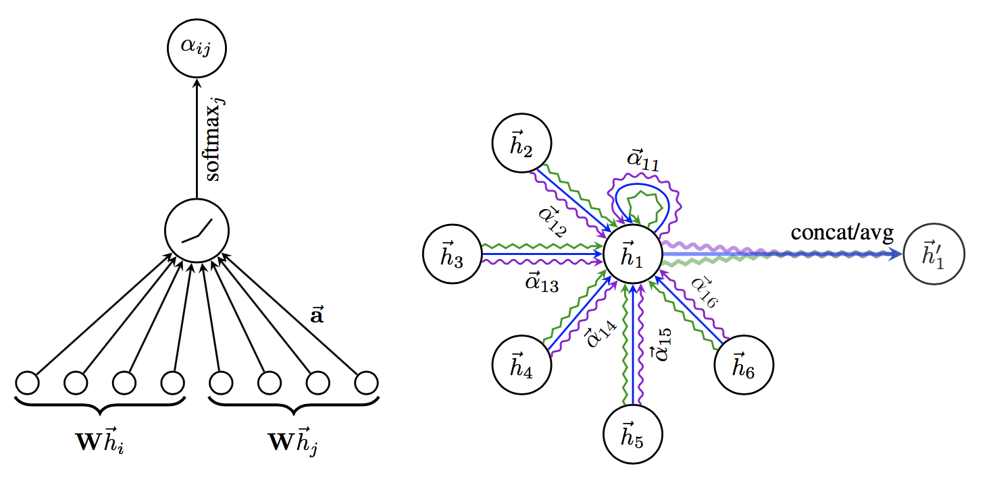
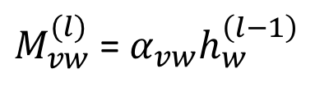
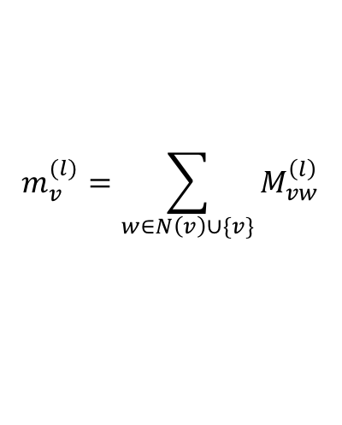
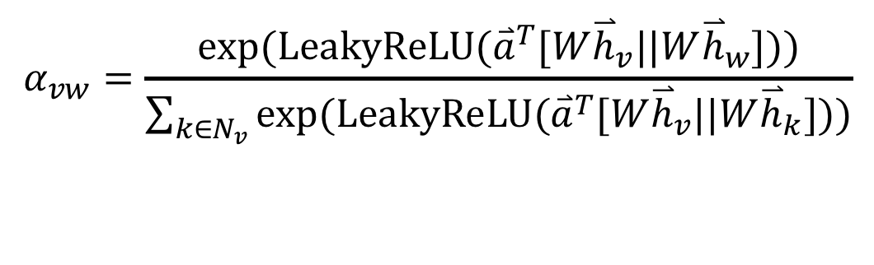
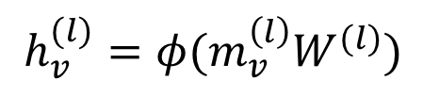
Example 2: Graph attention networks (GAT)
GAT provides weighted sum over the neighborhood—Enables to selectively integrate information.
$M_{vw}^{(l)}$= $α_{vw}h_{w}^{\left(l−1\right)}$
$$m_{v}^{(l)}=\sum_{w∈N\left(v\right)∪\{v\}}{M_{vw}^{\left(l\right)}}$$
$$h_{v}^{(l)}=φ(m_{v}^{\left(l\right)}W^{(l)})$$
$$α_{vw}=\frac{exp⁡(LeakyReLU({\overset{⃑}{a}}^{T}[W{\overset{⃑}{h}}_{v}||W{\overset{⃑}{h}}_{w}]))}{\sum_{k∈N_{v}}{exp⁡(LeakyReLU({\overset{⃑}{a}}^{T}[W{\overset{⃑}{h}}_{v}||W{\overset{⃑}{h}}_{k}]))}}$$

Slide 18
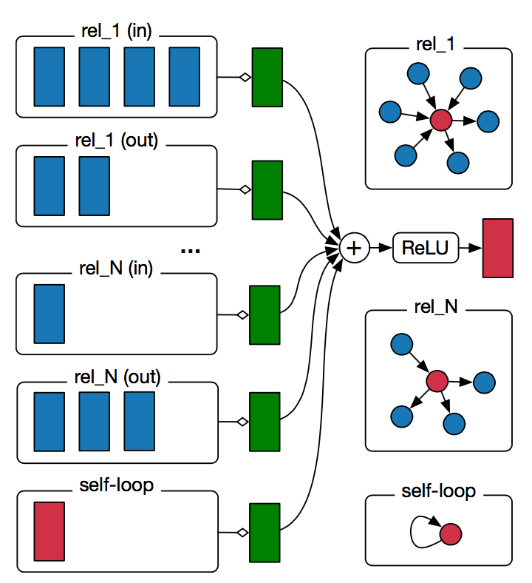
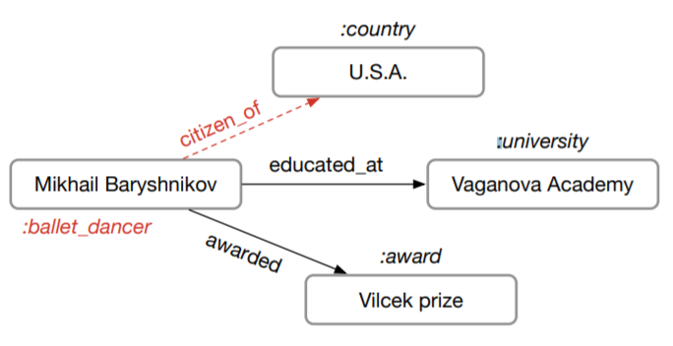
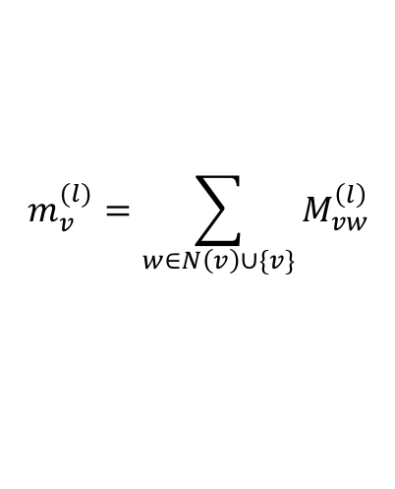
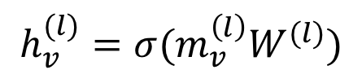
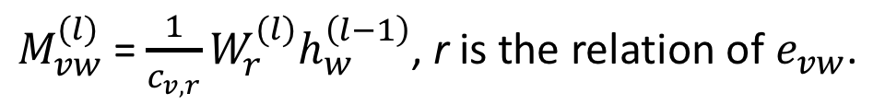
Example 3: Relational graph convolution networks (RGCN)
Handles graphs whose nodes are connected with different relations.
$M_{vw}^{(l)}$= $\frac{1}{c_{v,r}}W_{r}^{(l)}h_{w}^{\left(l−1\right)}$, r is the relation of $e_{vw}$.
$$m_{v}^{(l)}=\sum_{w∈N\left(v\right)∪\{v\}}{M_{vw}^{\left(l\right)}}$$
$$h_{v}^{(l)}=σ(m_{v}^{\left(l\right)}W^{(l)})$$

Slide 19
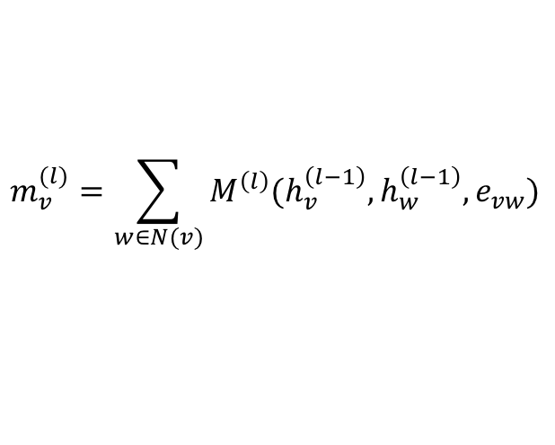
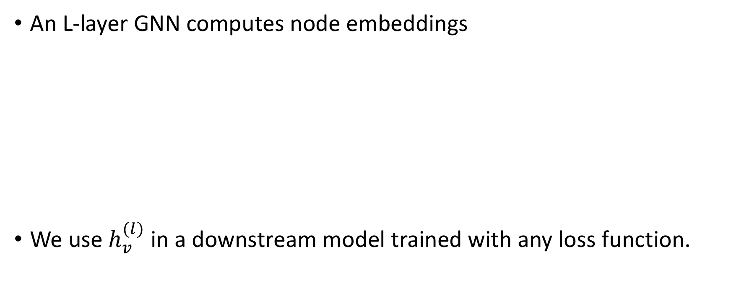
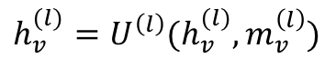
How to train an end-to-end GNN?
An L-layer GNN computes node embeddings
We use $h_{v}^{(l)}$ in a downstream model trained with any loss function.
$$m_{v}^{(l)}=\sum_{w∈N(v)}{M^{\left(l\right)}(h_{v}^{\left(l−1\right)}, h_{w}^{\left(l−1\right)}, e_{vw})}$$
$$h_{v}^{(l)}=U^{\left(l\right)}(h_{v}^{(l)}, m_{v}^{\left(l\right)})$$

Slide 20
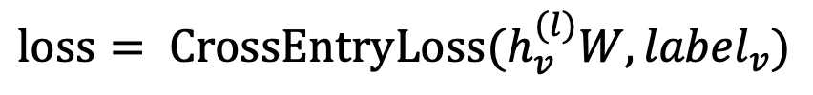
Node classification with GNN
Node classification is trained in the semi-supervised setting.
$$loss= {CrossEntryLoss(h}_{v}^{(l)}W, {label}_{v})$$
0
1
0
?
?
?

Slide 21
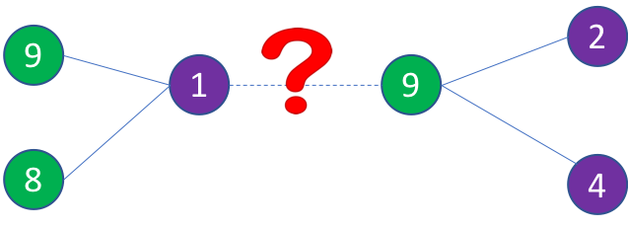
Link prediction with GNN
We train a link prediction model with connectivity of nodes as the training signal.
Positive edges are trained against a few negative edges
${loss= −log (σ⁡(h}_{v}^{T}h_{w}))−Q∙E_{u_{n}\sim P_{n}(v)}{log (σ⁡(−h}_{v}^{T}h_{u_{n}})$)
Positive edges
Negative edges
Graph convolution to
encode node embeddings
Graph convolution to
encode node embeddings

Slide 22
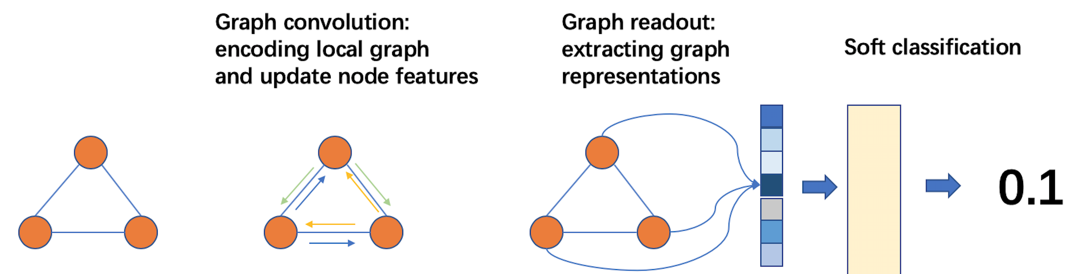
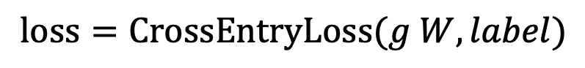
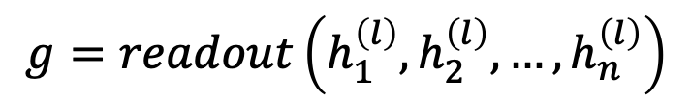
Graph classification
Graph readout to compute graph embeddings.
Train a graph classifier on the graph embedding.
$$g=readout\left(h_{1}^{\left(l\right)},h_{2}^{\left(l\right)}, …,h_{n}^{\left(l\right)}\right)$$
$$loss=CrossEntryLoss(g W, label)$$

Slide 23
How to train GNN on large graphs
Many applications have extremely large graphs—millions of nodes and billions of edges:
Social networks
Recommendation
Knowledge graph
…
A typical training method: mini-batch training

Slide 24
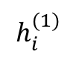
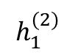
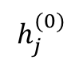
A glance of mini-batch training on graphs
A mini batch represents the computation graph for target nodes.
Small-world graphs lead to a huge computation graph.
2
3
$$h_{1}^{(2)}$$
1
1
10
5
$$h_{i}^{(1)}$$
2
3
4
5
6
9
4
6
8
7
$$h_{j}^{(0)}$$
1
3
4
6
7
8
9
10
11
11

Slide 25
Mini-batch with neighbor sampling
Prune the computation graph:
Sample neighbors from a neighbor list of a vertex.
1
1
2
3
4
5
6
2
4
1
7
8
1
3
4
6
7
8
9
10
11

Slide 26
Summary
The solution to many applications can be formulated as graphlearning problems.
Graph neural networks are a new technique for graph learning.
They have multiple advantages over traditional methods.
We demonstrate how GNNs are used in multiple graph tasks and how these GNN models can be trained.

Slide 27
Thank you!
DGL website: http://dgl.ai
DGL doc: http://doc.dgl.ai

Slide 28
Notebook setup
Please send an email to dgl-devday@request-nb.mxnet.io
You’ll get two replies in a few minutes. The second email contains a URL of the SageMaker notebook instance.

Slide 29
BACKUP SLIDES

Slide 30
Recommendations
Fraud & Abuse
Products, media, articles, experiences, jobs, courses, spouses, …
Detect malicious accounts, fraudulent financial transactions, fake reviews, fraudulent insurance claims, …
Marketing
Who should get a discount? Who are the influencers? Who are the risk of churning?

Slide 31
A graph view of the business problems
Social network
Financial transactions network
Collaborative knowledge graph

Slide 32
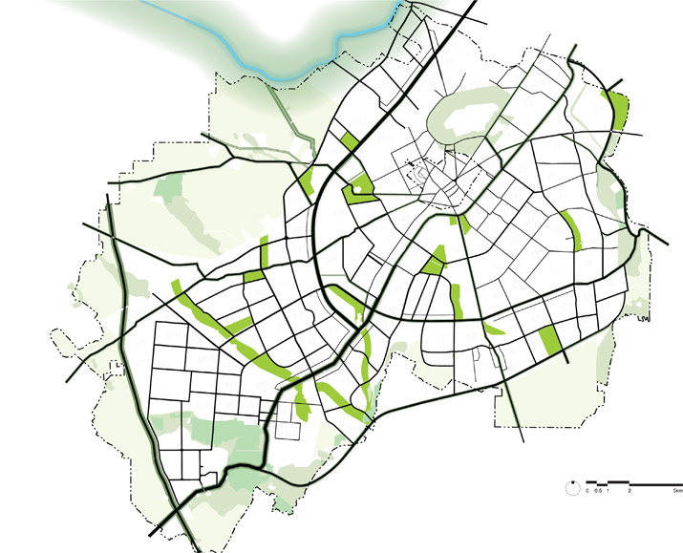
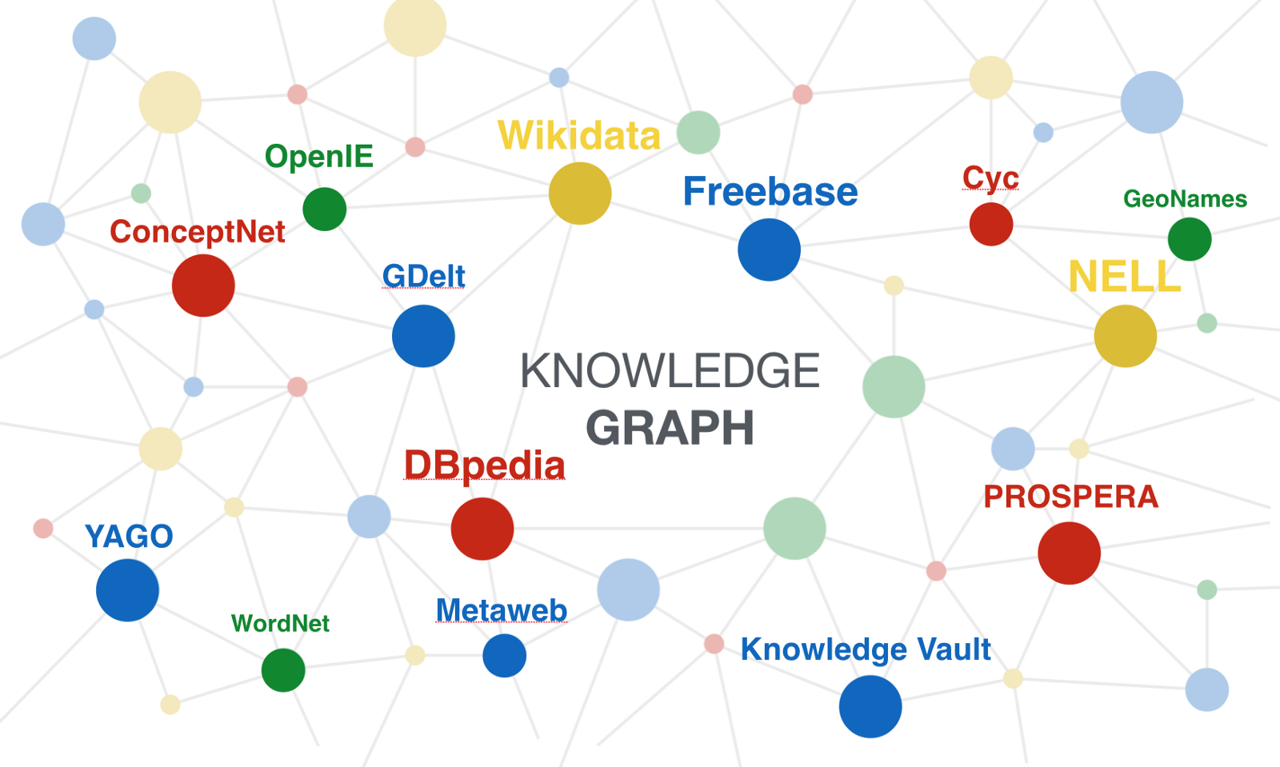
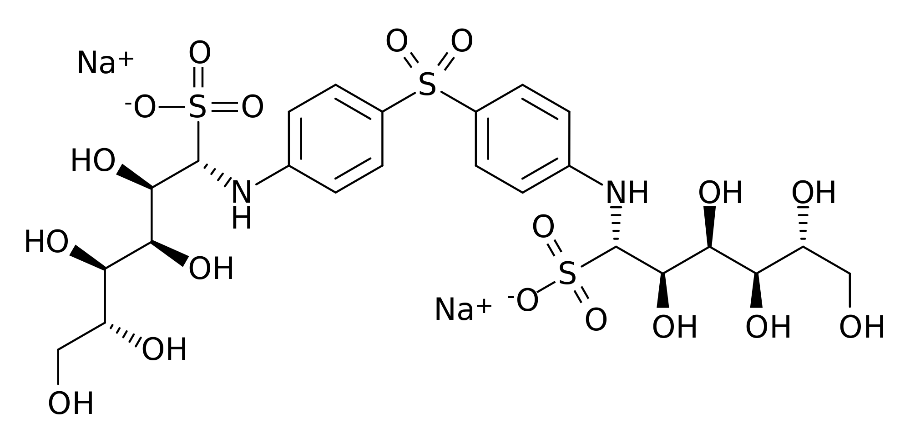
More graph problems
Drug discovery
Knowledge graph
Road network

Slide 33
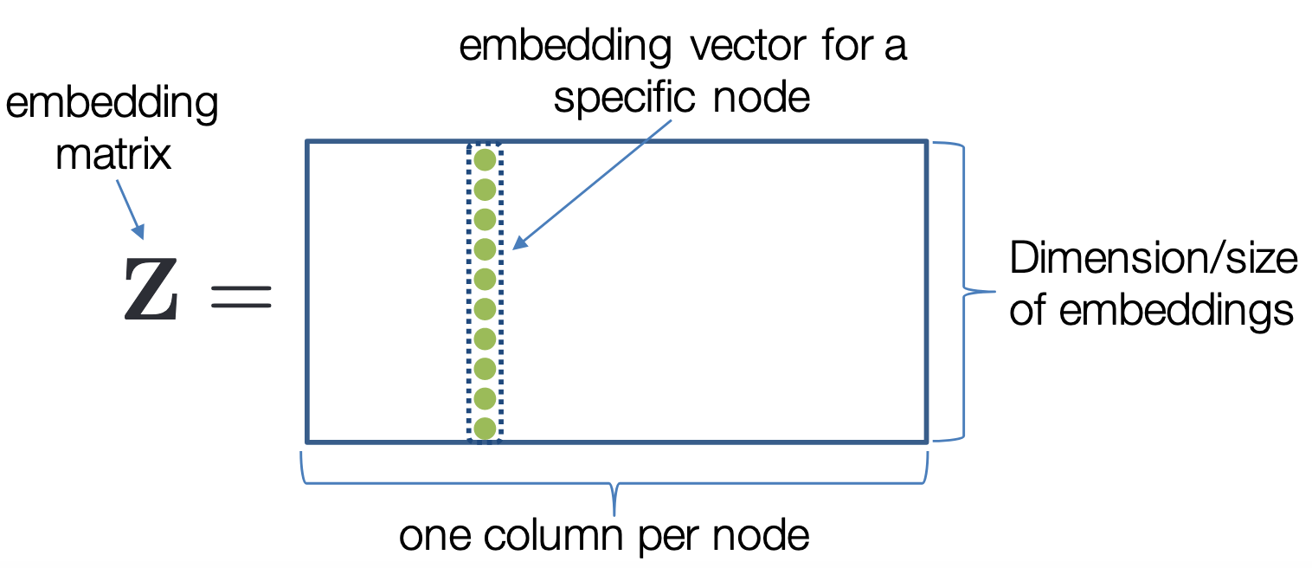
Traditional methods for network embedding
Network embeddings
Matrix factorization
Tensor decomposition
Deep Walk
Autoencoder
…
Traditional methods use embedding matrix to encode.
Representation Learning on Networks, snap.stanford.edu/proj/embeddings-www, WWW 2018

Slide 34
Limitations in traditional methods
Problems:
Traditional methods are all transductive.
Only learn from the graph structure.
Network embeddings cannot be trained with the supervision from the downstream tasks.

Slide 35
Graph learning requires to embed nodes
Embed nodes to low-dimension space so that similarity in the embedding space approximates similarity in the original graph.
Representation Learning on Networks, snap.stanford.edu/proj/embeddings-www, WWW 2018

Slide 36
A graph neural network (GNN) is a class of neural networks for learning nodes, edges, and graphs embeddings.
GNN
Classifier

Slide 37
Deep learning + Graph
GNN is emerging as an important class of DL models.

Slide 38
More explanation on GCN
Problems:
GCN aggregate all neighbors equally.
It cannot deal with heterogeneous graphs.

